Slide 1
PRESENTER NAME:IRENE UFUOMA AYAKAZI
FACILITATOR’S NAMES:
MR OLUWOLE ,
MR ISAAC OLakunle,
MR BLESSING OLORUNFEMI
DSA PROJECT TOPIC: LOAN APPROVAL PREDICTION
DATE: JULY 3RD, 2025

Slide 2
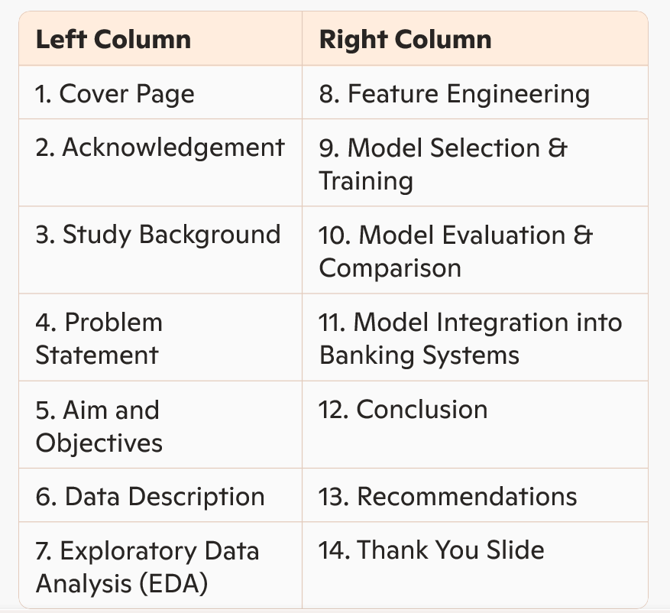
TABLE OF CONTENT

Slide 3
ACKNOWLEDGEMENT
As a graduate economist with a passion for data, my journey into the world of technology has been both intentional and transformative.
Eleven months ago, I was honored to receive a scholarship to study Data Analysis through the Incubator Hub, organized by Ladies in Tech Africa (LITA). That opportunity laid a solid foundation for my transition into tech and fueled my curiosity for deeper, data-driven innovation.
In April of this year, I was once again privileged to earn a scholarship to study Artificial Intelligence and Machine Learning, this time under the same incubator hub powered by Digital Skillup Africa (DSA). This milestone became even more meaningful as I connected with talented colleagues in a vibrant virtual community, engaging in hands-on learning sessions three times a week.
Special thanks to our brilliant instructors—Mr. Oluwole Olajide, Mr. Isaac Olakunle, and Mr. Blessing Olorunfunmi—whose expertise, mentorship, and unwavering support brought the curriculum to life and empowered me to thrive in this fast-evolving field.
To everyone who has been part of this journey—I remain deeply grateful.

Slide 4
STUDY BACKGROUND
Traditional loan approval methods rely heavily on manual reviews, which can be slow and inconsistent.
Machine learning offers a faster, more accurate way to evaluate loan applications using historical data.
Financial indicators like income, credit score (CIBIL), assets, and employment status are key features in prediction.
ML models help identify patterns in applicant data, enabling smarter, data-driven lending decisions.
Automating the loan process reduces administrative workload and enhances operational efficiency.
The study also aims to uncover influential factors in loan approvals, promoting transparency and financial literacy.

Slide 5
PROBLEM STATEMENT
Manual loan processing is time-consuming, often leading to delays in decision-making
and customer dissatisfaction.
Inconsistent approval criteria across different loan officers can result in biased
or unfair decisions.
Limited predictive insight into applicants’ financial behavior makes risk assessment
less effective and prone to errors.
Repetitive administrative tasks consume valuable staff time that could be better
used for strategic operations.
Lack of data-driven analysis hinders understanding of which financial indicators
truly affect loan approval outcomes

Slide 6
Aim and Objectives
PROJECT AIMS
Enhance loan decision-making through intelligent data-driven systems that ensure fair and consistent approval processes.
Leverage machine learning techniques to predict loan eligibility, increasing accuracy and reliability in financial evaluations.
Optimize operational efficiency by automating key aspects of loan processing, reducing human involvement in repetitive tasks.
Identify influential financial factors affecting loan approvals, offering insights to improve policy-making and financial modeling.
Support financial institutions in minimizing risk and maximizing customer satisfaction through predictive analytics.
PROJECT AIMS
Enhance loan decision-making through intelligent data-driven systems that ensure fair and consistent approval processes.
Leverage machine learning techniques to predict loan eligibility, increasing accuracy and reliability in financial evaluations.
Optimize operational efficiency by automating key aspects of loan processing, reducing human involvement in repetitive tasks.
Identify influential financial factors affecting loan approvals, offering insights to improve policy-making and financial modeling.
Support financial institutions in minimizing risk and maximizing customer satisfaction through predictive analytics.
Objectives THE PRIMARY OBJECTIVES OF THIS PROJECT ARE:
To develop a machine learning model that predicts loan approval based on applicant data.
To analyze key financial indicators such as income, credit score (CIBIL), assets, and employment status to improve prediction accuracy.
To automate the loan approval process, reducing manual workload and enhancing efficiency.
To provide insights into factors that influence loan approval decisions.

Slide 7
DATA DESCRIPTION
Loan ID – Unique identifier for each loan application.
No of Dependents – Number of financial dependents the applicant has.
Education – Applicant’s education level, which may affect earning potential.
Self Employed – Indicates whether the applicant is self-employed.
Income Annum – Annual income of the applicant.
Loan Amount – Requested loan amount.
Loan Term – Duration for which the loan is granted.
CIBIL Score – Credit score reflecting the applicant’s repayment history.
Residential, Commercial, and Luxury Assets Value – Financial assets owned by the applicant.
Bank Asset Value – Total bank balance and financial holdings.
Loan Status – Final decision on loan approval (Approved/Rejected).
Understanding the above features helps in building a robust predictive model.

Slide 8
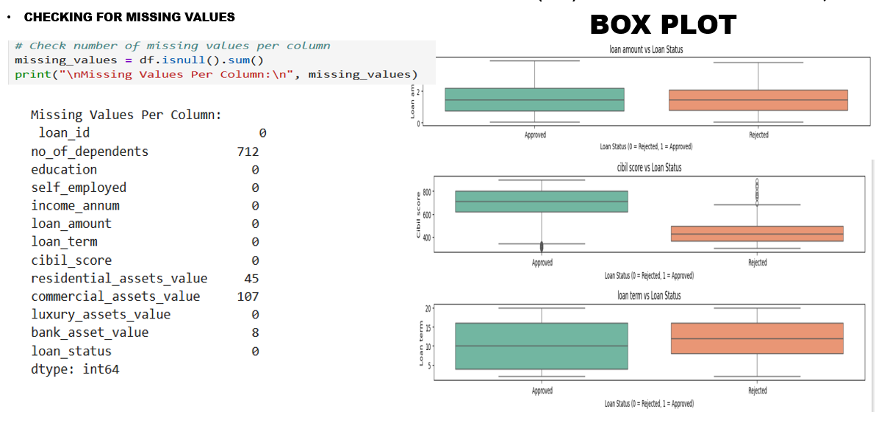
METHODOLOGY OVERVIEW
EXPLORATORY DATA ANALYSIS
EDA is a crucial step in understanding the dataset before model training. EDA helps in refining the dataset and ensuring high-quality inputs for the machine learning model.
It involves:
Checking missing values and handling them appropriately.
Visualizing data distributions using histograms and Box count plots.
Identifying correlations between features using heatmaps.
Detecting outliers that may affect model performance.

Slide 9
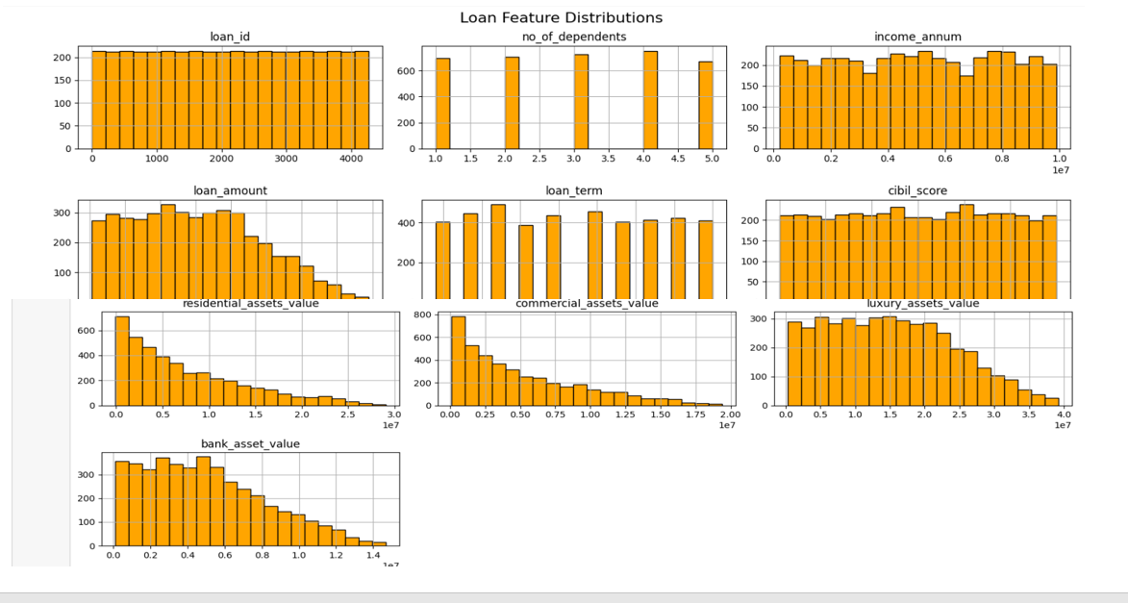
HISTOGRAM
Use this slide to describe data, and models develoed, etc. Use more slides if necessary

Slide 10
A BREIF INSIGHTS ON EDA CARRIED OUT
MISSING VALUES (BOTTOMS SECTION)
No_of_dependents has the most missing entries (712), possibly due to applicant omission or data collection issues.,
Commercial_assets_value has 107 missing values, Residential Asset Value has 45 missing values , while other columns are fully complete.
Key demographic and financial variables like education, income_anum, and loan_amount are complete, which is good for predictive analysis.
BOX PLOTS
Loan Amount vs. Loan Status: Likely reveals that larger loan amounts may be more frequently rejected, suggesting risk-based filtering.
CIBIL Score vs. Loan Status: Shows higher scores are associated with approvals, highlighting its predictive value
DESCRIPTIVE STATISTICS OVERVIEW
The Table Presents Summary Statistics For Various Numerical Columns In The Dataset.
The Key figures Reveals;
income_annum:
Mean (average): around 2.23e+06, meaning 2.23 million
Min: 180,000, Max: 9 million, showing a wide range with some high earners
Cibil_score:
Centered around 757, with a minimum of 300 and a high of 939. This aligns with typical CIBIL score ranges (300–900), suggesting valid data.
Asset Values (residential, commercial, luxury, bank):
Most values have minimums of 0, indicating many applicants may not own assets in certain categories
Luxury assets and bank assets have lower means and max values

Slide 11
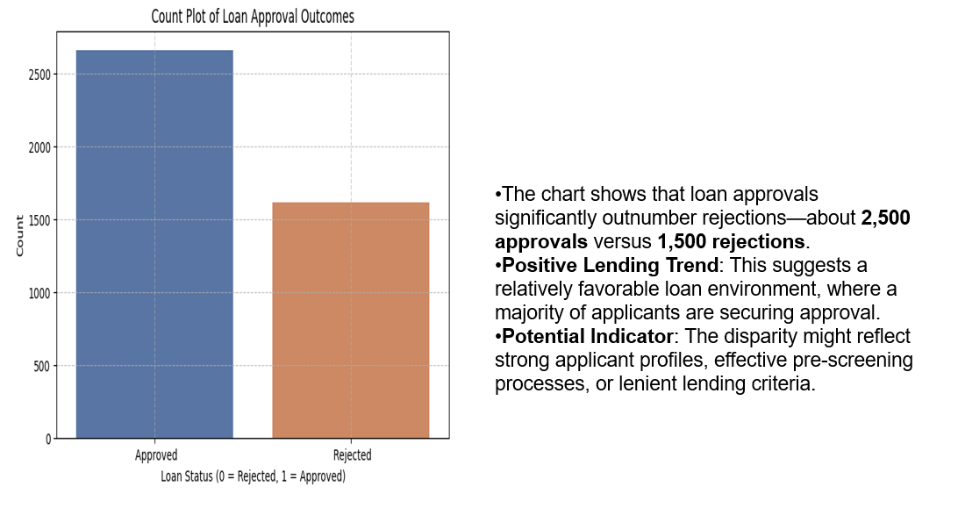
LOAN APPROVAL BAR CHART

Slide 12
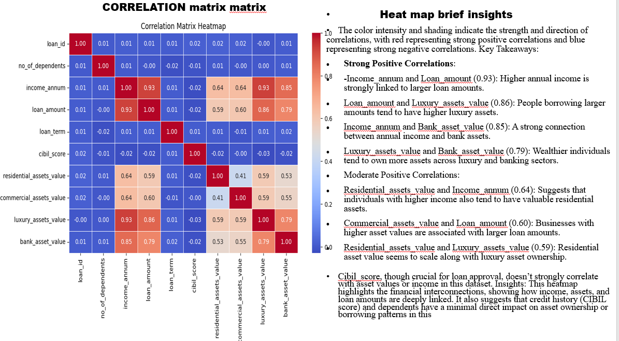
Results

Slide 13
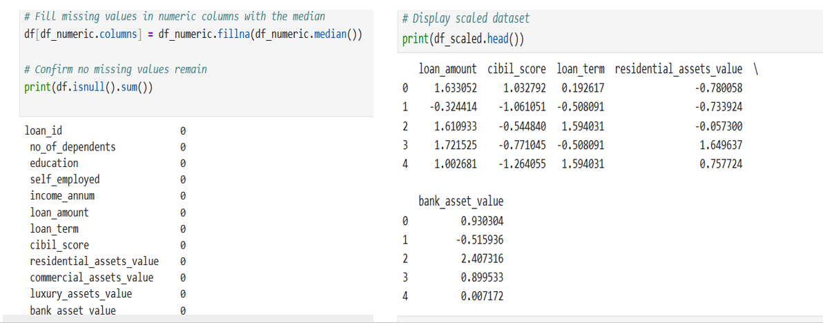
FEATURES ENGINEERING
Feature engineering involves transforming raw data into meaningful inputs for the model.
Key steps include;
Handling missing values by filling numeric values with (median)
Scaling numerical features with Standard Scaler ensure uniformity in data distribution.
Selecting relevant features that contribute significantly to loan approval prediction

Slide 14
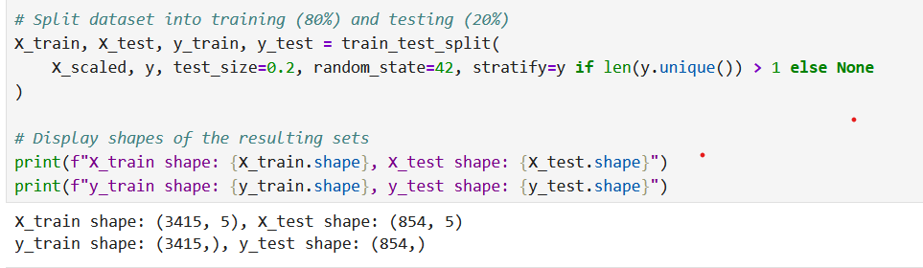
MODEL SELECTION AND TRAINING
Compared Logistic Regression and XGBoost algorithms
Trained on an 80:20 split to evaluate generalization.
Tuned hyperparameters to boost precision and reduce false predictions.

Slide 15
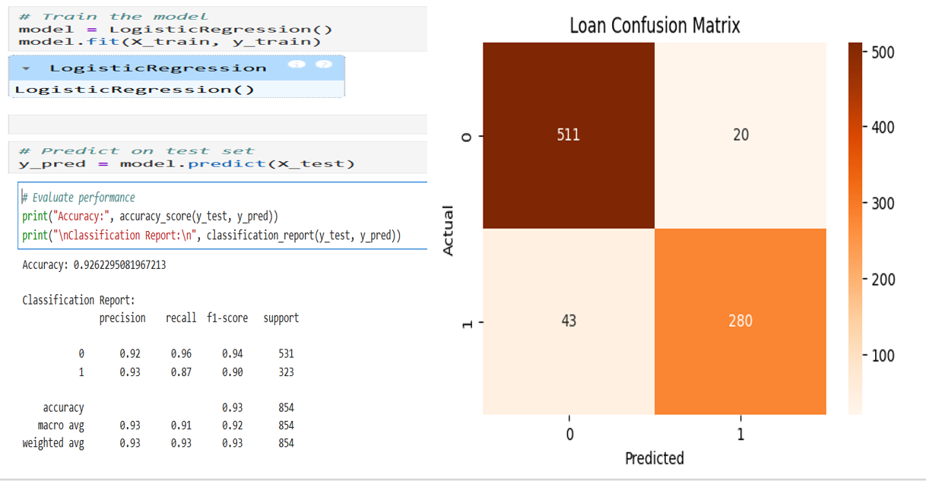
MODEL TRAINING USING LOGISTIC MODEL

Slide 16
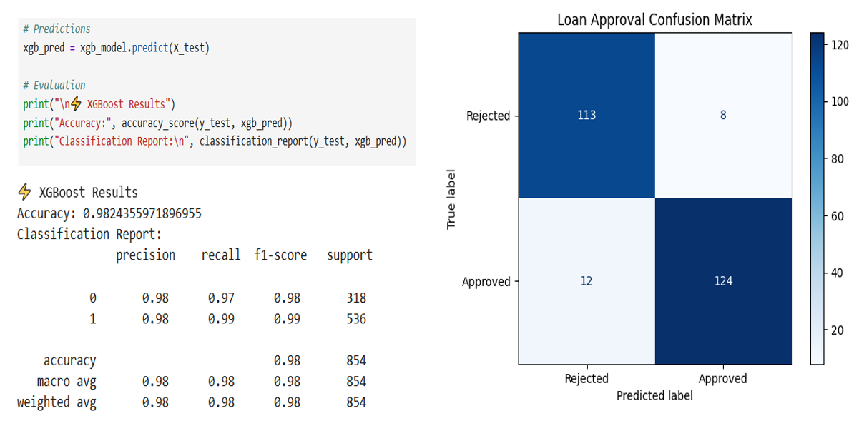
MODEL TRAINING USING XGBOOST

Slide 17
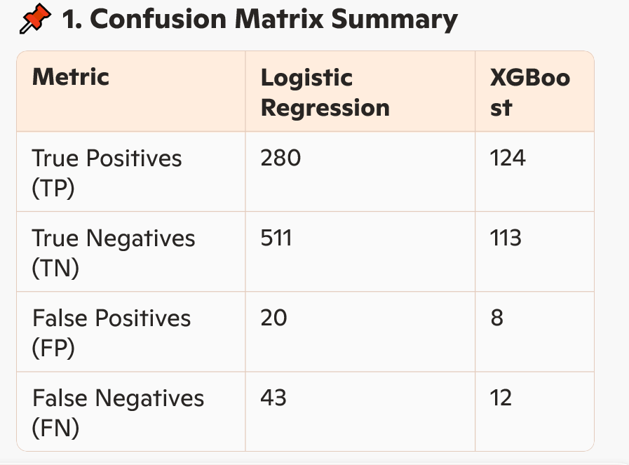
Breakdown Comparing the Logistic Regression and XGBoost models used for predicting loan approvals, using key classification metrics:

Slide 18
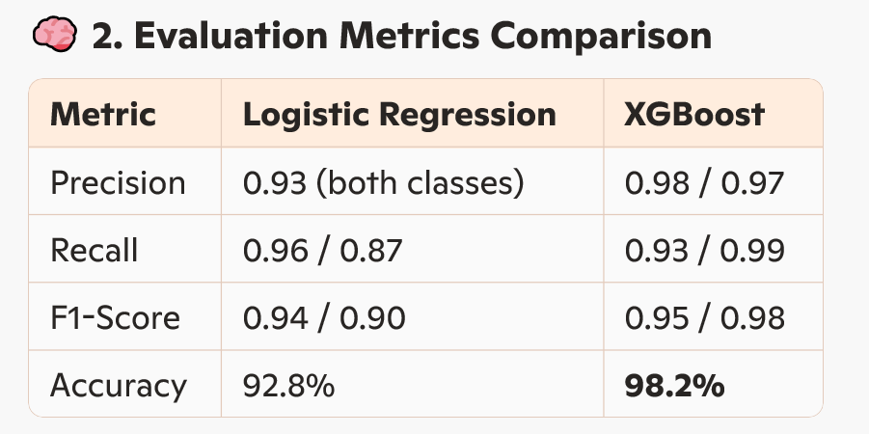

Slide 19
EVALUATION METRICS COMPARISON
Precision: XGBoost Is more precise. It makes fewer “false alarms” when predicting approvals.
Recall: XGBoost recovers more of the true approvals (99% recall on class 1), minimizing missed opportunities
F1-Score: XGBoost shows stronger balance between precision and recall—especially for class 1 (loans approved
Accuracy: XGBoost wins with 98.2%, indicating overall better performance across the board.
Brief Insight
While Logistic Regression performs decently, XGBoost clearly outshines it in nearly every metric—fewer false positives and negatives, greater precision and recall, and a much higher overall accuracy. This suggests XGBoost is more reliable, especially when loan approval errors have financial consequences.

Slide 20
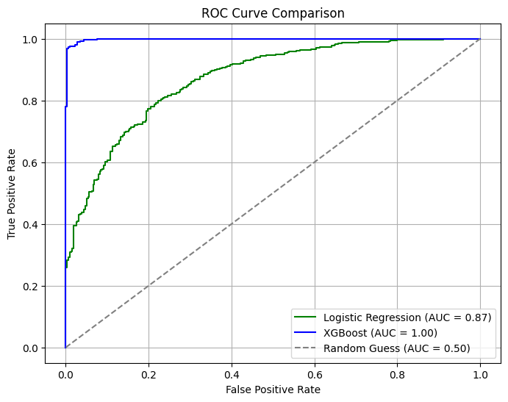
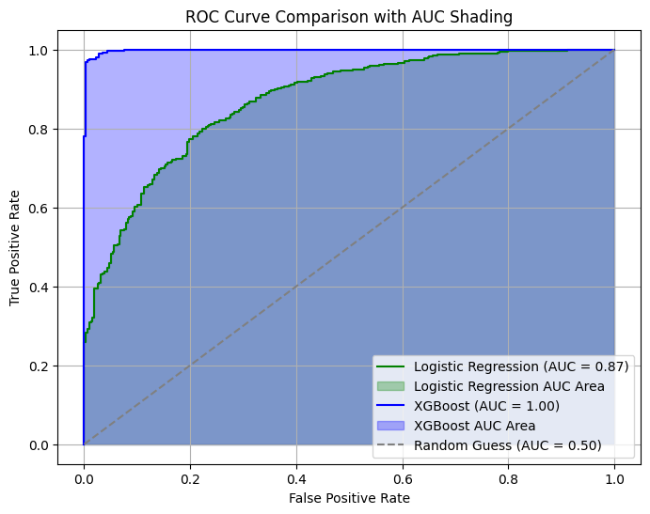
ROC CURVE AND ROC CURVE COMPARISON WITH AUC SHADING
.

Slide 21
ROC CURVE & ROC CURVE COMPARISON WITH AUC SHADING
The above images provides a visual and quantitative comparison of two models using ROC curves (Receiver Operating Characteristic) and their associated AUC (Area Under the Curve) values.
1. Logistic Regression
AUC Score: 0.87
Interpretation: This model has decent discriminatory power—it can distinguish between approved and rejected loan applicants 87% of the time.
Curve Shape: The ROC curve rises above the diagonal (random classifier line), showing skillful performance, but there's room for improvement.
2. XGBoost
AUC Score: 1.00
Interpretation: This model demonstrates perfect classification ability. An AUC of 1.00 means it flawlessly separates approved vs. rejected applicants in this data.
Curve Shape: The ROC curve hugs the top-left corner—exactly what we want from an ideal classifier.
Business Takeaway
XGBoost clearly outperforms Logistic Regression, making it the preferred model when minimizing misclassification is critical—such as in financial approval systems.
AUC is especially important when class distributions are imbalanced, and this result confirms XGBoost's reliability for high-stakes decisions.

Slide 22
MODEL INTEGRATION INTO BANKING SYSTEMS
1. This project demonstrates how machine learning can be effectively integrated into a banking infrastructure to streamline loan approvals.
Backend Integration: Model deployed in the bank’s decision engine for real-time predictions based on features like credit score, income, and employment.
Backend Integration: Model deployed in the bank’s decision engine for real-time predictions based on features like credit score, income, and employment.
API Deployment: Wrapped in a secure RESTful API using Flask, enabling seamless interaction with core banking software.
Hosting: Adaptable across cloud platforms (e.g., Azure, AWS) or on-prem environments for regulatory compliance
🔗 Live Model Prediction Link:
👉 https://loan-prediction-app-igu6.onrender.com
Allows loan officers to input data and receive predictions instantly.
2. USER INTERFACE FOR LOAN OFFICERS
Dashboard: Intuitive input form with instant loan prediction and confidence score.
Explain-ability Tools: Integrated SHAP or LIME to visualize feature influence for each decision
Alerts: Flags uncertain or borderline applications for manual review.

Slide 23
MODEL INTEGRATION INTO BANKING SYSTEMS
Feedback Collection Link:
👉 https://loan-prediction-app-feedback-page.onrender.com/
Supports gathering real-world user insights to improve model performance and trustworthiness.
3. Fairness & Bias Monitoring
Bias audits to evaluate performance across gender, age, etc.
Periodic retraining with fresh data
Ethical rules for human overrides when needed
4. Operational Impact
Faster decision turnaround (seconds vs. days)
98%+ accuracy using XGBoost
Low error rates (only 8 FPs and 12 FNs)
5. Real-World Value
Enhanced customer satisfaction and trust
Regulatory alignment with audit tools and fairness tracking
Scalable framework usable across diverse credit products

Slide 24
CONCLUSION
This machine learning–powered loan prediction system demonstrates how data-driven intelligence can streamline financial decision-making. With a high-performing XGBoost model achieving:
98.2% accuracy
Low false approvals (FP = 8) and missed opportunities (FN = 12)
Perfect AUC score (1.00) on test data,
it clearly surpasses traditional models and manual vetting techniques.
Ongoing improvement—through real-time updates, expanded features, and fairness checks—will ensure the model stays robust, transparent, and trustworthy
The deliverables (trained model, Flask app, API, test link, and code) position this solution as ready for production deployment across banking institutions, offering:
Faster approvals
Reduced human error
Enhanced customer experience
Stronger compliance mechanisms

Slide 25
RECOMMENDATIONS
Model Enhancement & Diversity
Leverage ensemble techniques or blend XGBoost with LightGBM or deep learning for edge cases.
Perform hyperparameter tuning using GridSearch or Optuna to squeeze out additional performance gains.
Feature Engineering & Data Expansion
Include alternate financial signals like:
Credit utilization ratio
Past loan repayment behavior
Employment history or stability index
Integrate real-time credit bureau checks to enhance prediction accuracy
3, Fairness and Bias Monitoring
Deploy post-training monitoring tools to track predictions across age, gender, and location segments.
Implement fairness constraints during training (e.g., adversarial de-biasing or reweighing methods).
4. Interface & Usability
Improve the Flask front end by:
Adding form validation and input error checks
Displaying not just binary results but confidence scores and explanation visuals using SHAP
Add audit logs and exportable decision summaries for compliance teams.
5. Scalability & Integration
Wrap the model in a Docker container for easier deployment across environments.
Use CI/CD pipelines to deploy regular updates with minimal downtime.
6. Customer Feedback Loop
Collect user feedback post-loan decision to analyze mismatches or perceived errors—then feed this back into retraining cycles

Slide 26
Thank You for Listening

